Slide 1
LJ institute of computer application
MCM :: SEM-3
Music Recommndation system
Dhara Bhanderi : 185190686002
Kartik Trivedi: 185190686031
Bhautik Chodvadiya: 185170686010

Slide 2
Music Recommndation System
- This program work as a “MUSIC PLAYER”.
- Data structure of linklist is used in this project.
- You can listen to any music you want available in your system.
- With linklist we have fatched songs from the respected file.
- We have also used it to direct it for next song and previous song.
- You can create your own login.

Slide 3
Data Structure
- Linked lists are among the simplest and most common data structures. They are also a great place to start because the linked list is a data structure that many other data structures use internally in their own structure.
- Understanding linked lists will help your understanding of "pointers" and how memory is stored and accessed by the system.
- To make things easier, I've included a visual representation of what a linked list looks like conceptually.

Slide 4
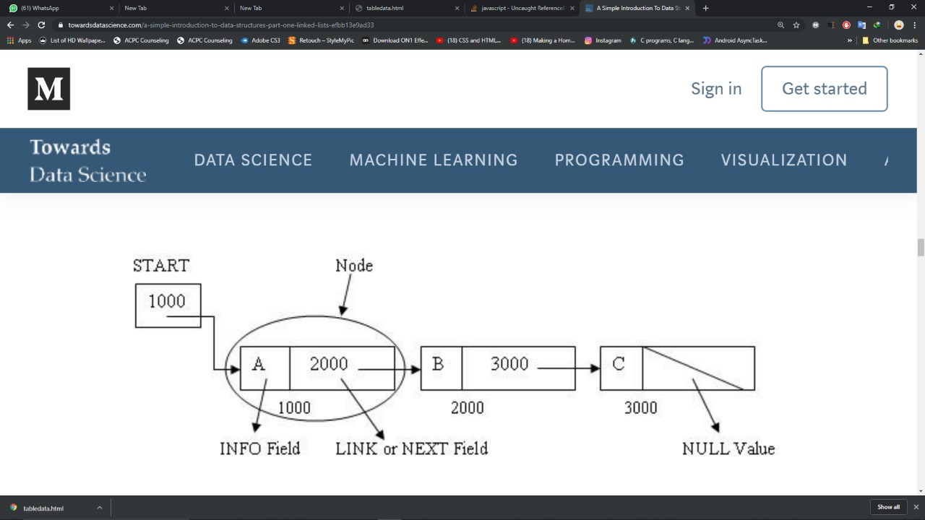
Link list diagram

Slide 5
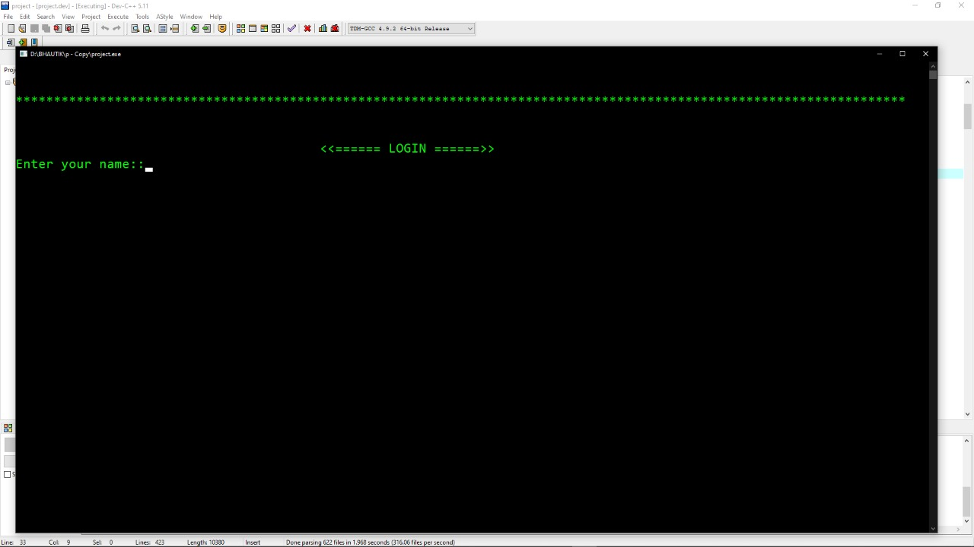
Description
MODULE 1:
- In this module the user will enter the name for the next move.The user name are store in the file in the same folder Project.
-next display is show the user name and user are must be enter choice for choose playlist song, random song and favourite song.

Slide 6
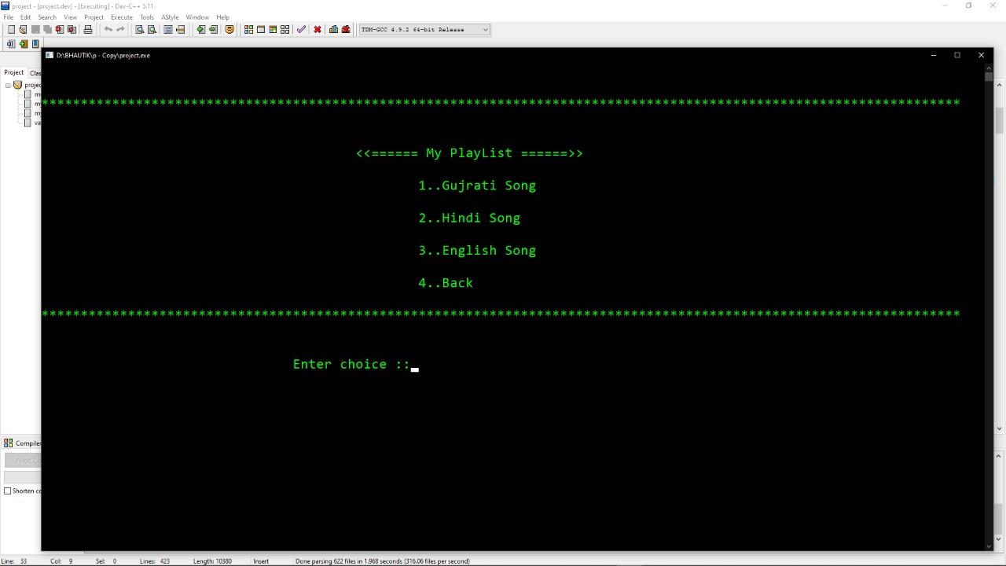
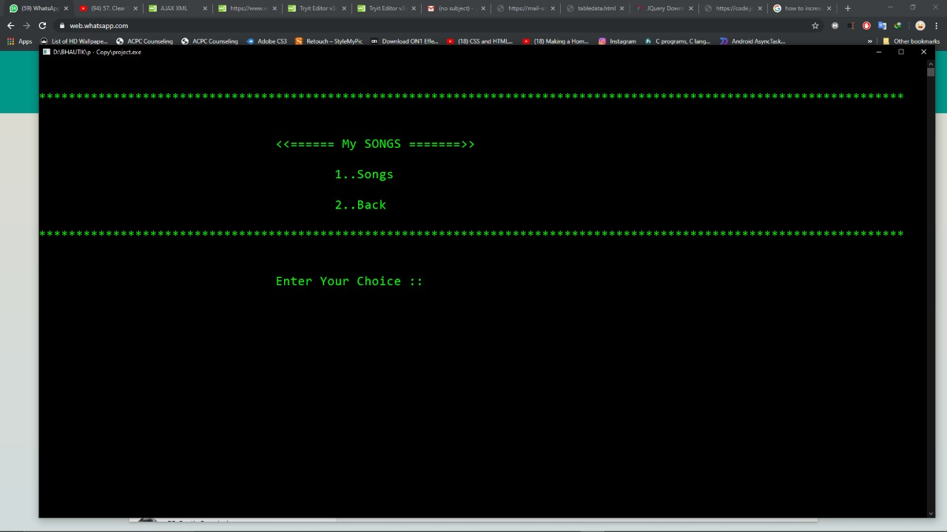
Description
MODULE 2:
- in this module user are choose the playlist song than show this display.
- here give the choose the song type like this gujarati song,hindi- song,english song
-user enter the ' 1 ' than go the into gujrati song module .
-as the other module are same like that gujrati song module.

Slide 7
Description
MODULE 3:
- in this module are show the list out the song list,
this song are store into the gujrati song name folder.
- in this module are user can to play song,
and after the next song ,previous song ,random song play and user are can song add into the favourite song.
-as the other module are same like that gujrati song module.

Slide 8
THANK YOU

